Slide 1
Real-World architecture
Problem demo
luismanez/high-volume-data-durable-function-test (github.com)
Orchestrator stuck when processing High volume data (with source code to reproduce it) · Issue #2020 · Azure/azure-functions-durable-extension (github.com)
How Durable functions work
Why it fails (twitter thread)
Demo Azure Storage and how it breaks
(as curiosity, show this: azure-services-periodic-table-v1-1.pdf (wordpress.com))
Comment this post: Common Pitfalls with Durable Execution Frameworks, like Durable Functions or Temporal | by Chris Gillum | Aug, 2022 | Medium
Storage options
Durable Task SQL Provider (microsoft.github.io)
Netherite Workflow Execution Engine (microsoft.github.io)
Differences
https://docs.microsoft.com/en-us/azure/azure-functions/durable/durable-functions-storage-providers#comparing-storage-providers
SQL provider demo
Netherite demo
Conclusions

Slide 2
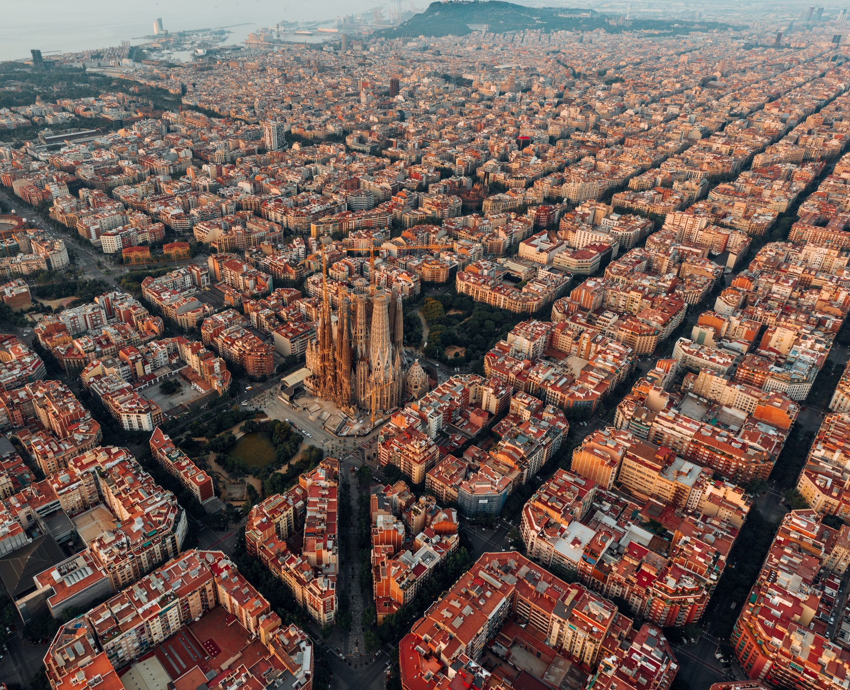

Storage Providers for Durable Functions
2022
The Good, the Bad and the Ugly
17/09/2022

Slide 3






About me
Luis Mañez
Chief Architect @ ClearPeople
M365 Development MVP. More than 20 years of experience working with Microsoft Technologies. MS Certified specialist in Developing Azure and SharePoint MCPD. Passionate about technology, blogger, technical writer and MS community active member.
@luismanez

Slide 5
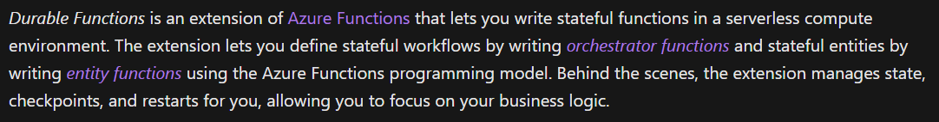
What are Durable Functions

Slide 7


Slide 8


Slide 9

BUT
WHY?

Slide 10







Durable Functions Real-World Architecture
SyncItem 1
SyncItem 2
GetDataToSync
CleanUp
Notifications / Analytics
SyncItem 3
.
.
.
SyncItem N

Slide 11
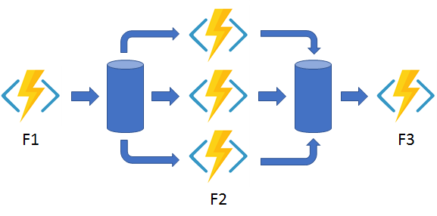
Durable Functions Fan out/fan in Pattern
https://docs.microsoft.com/en-us/azure/azure-functions/durable/durable-functions-overview?tabs=csharp#fan-in-out

Slide 12

Let´s dive in!
Durable Function with Azure Storage Provider

Slide 13
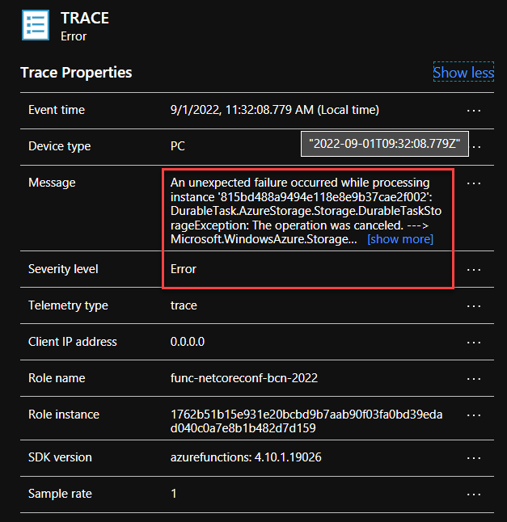
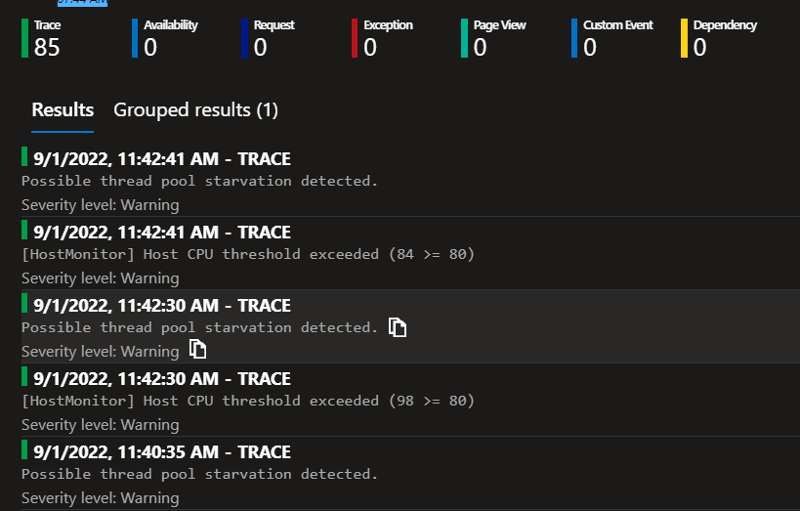

Slide 14
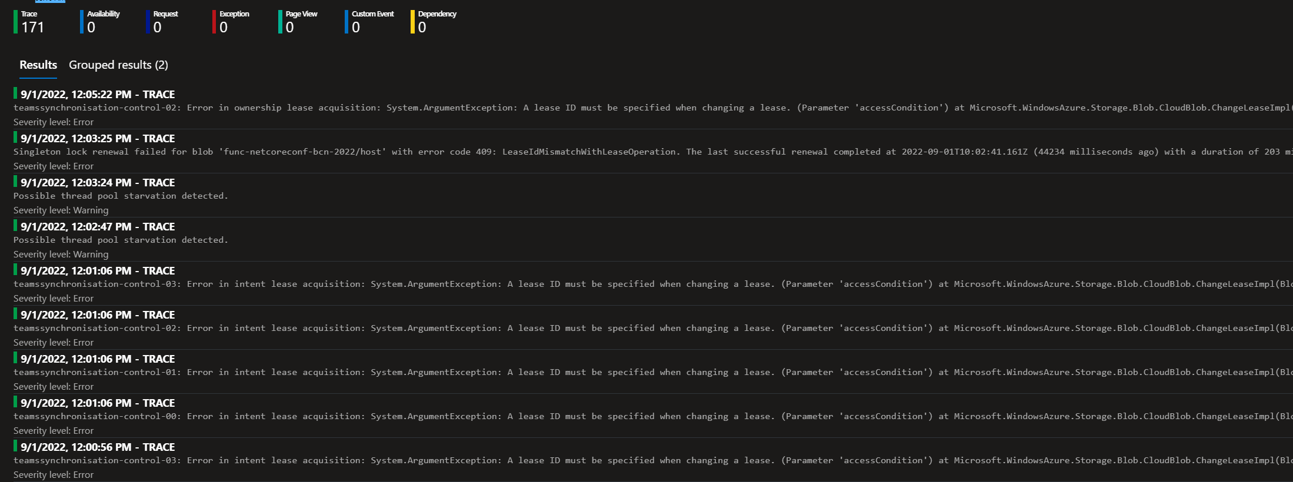
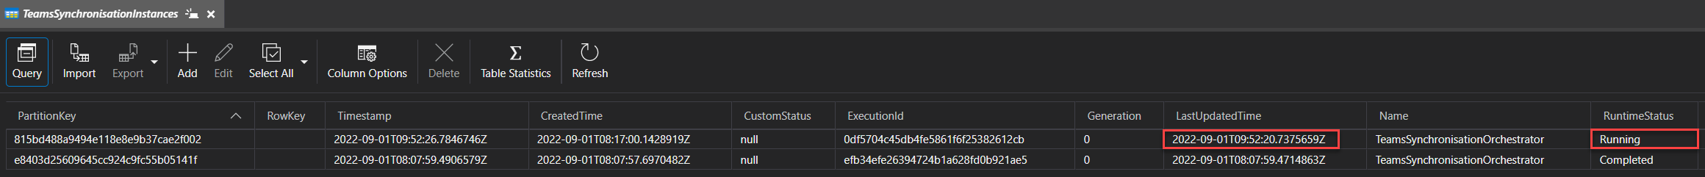
Orchestrator Stuck!!
Current Date Time: 2022-09-01T12:16Z

Slide 15
Let´s dive in!
Durable Function with SQL Server Storage Provider

Slide 16
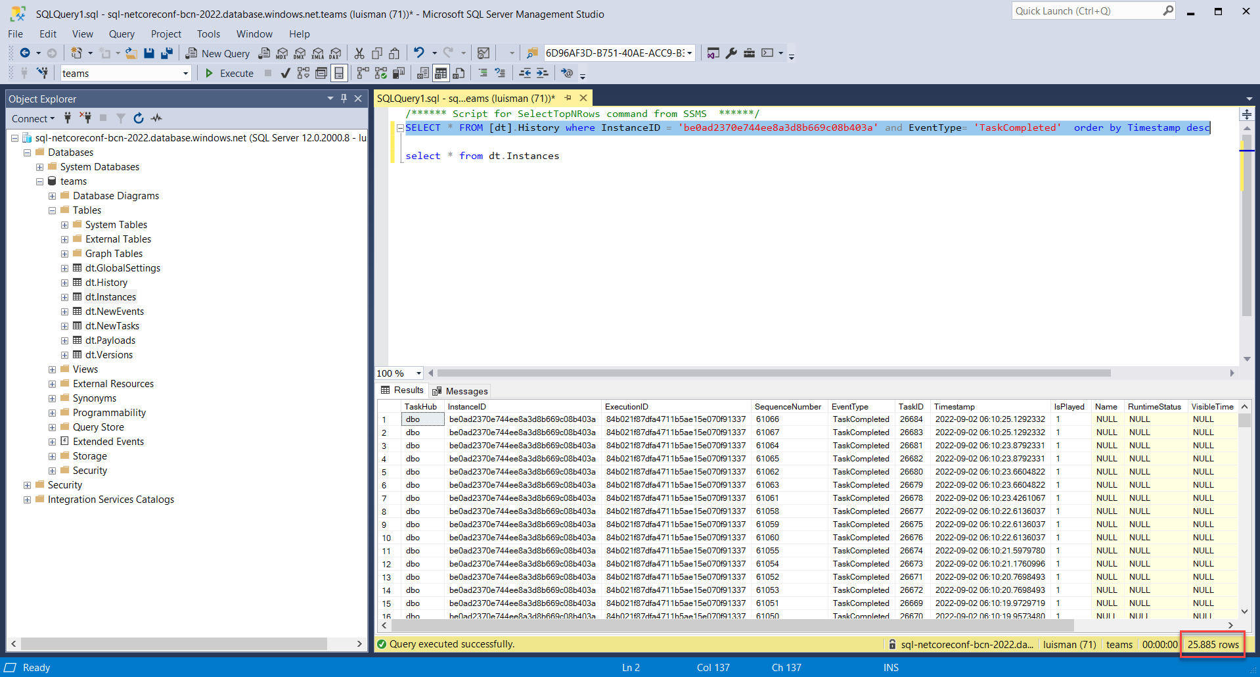
Orchestrator Stuck!!
After Processing during more than 27 hours
25,885 Items processed

Slide 17
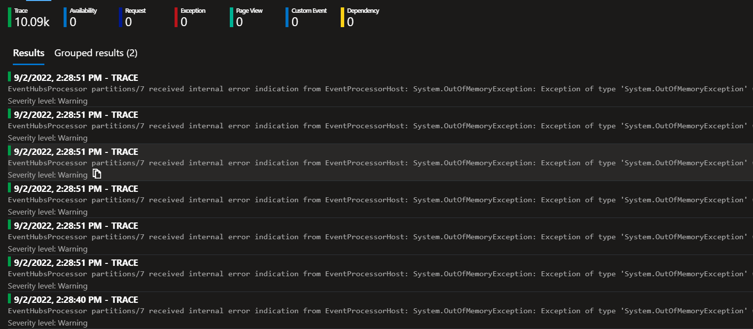
Netherite con App service P1V2

Slide 18
https://github.com/luismanez/netcoreconf-bcn-2022

Slide 20
More information:
info@netcoreconf.com
@Netcoreconf
Visit on:
netcoreconf.com
Thank´s

